Slide 1

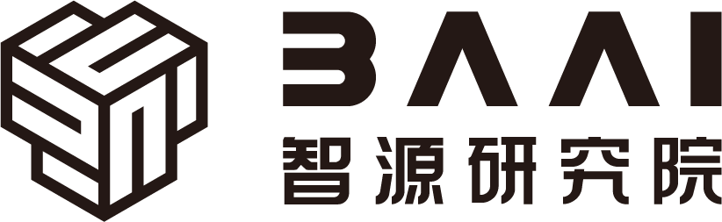

Hardware and Software Fundamentals of Intelligent Computing Systems

Slide 2
Lecture 22: Operator Fusion Pass

Slide 3
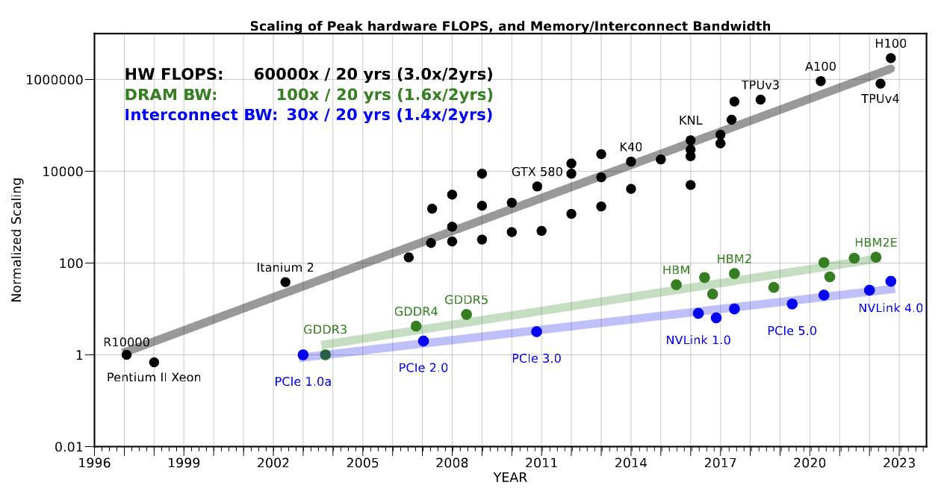
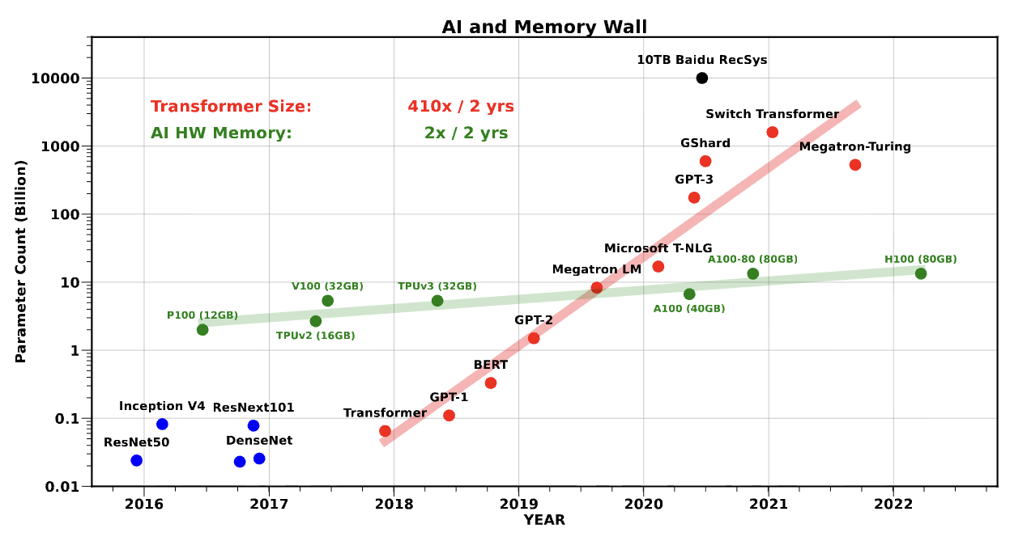
Why Perform Operator Fusion
Memory Wall (Memory Wall) Phenomenon: The computational bottleneck has shifted from ALU ALU compute power to memory bandwidth and data transfer latency.
Cost of Frequent Memory Access: In unoptimized computation graphs, each operator must go through the complete“read main memory -> compute -> write main memory” lifecycle.
Introducing Operator Fusion: By merging computation kernels, keeping intermediate results in L1/L2 Cache or registers, breaking through memory bottlenecks .
Gholami, A., Yao, Z., Kim, S., Hooper, C., Mahoney, M. W., & Keutzer, K. (2024). Ai and memory wall. IEEE Micro, 44(3), 33-39.

Slide 4
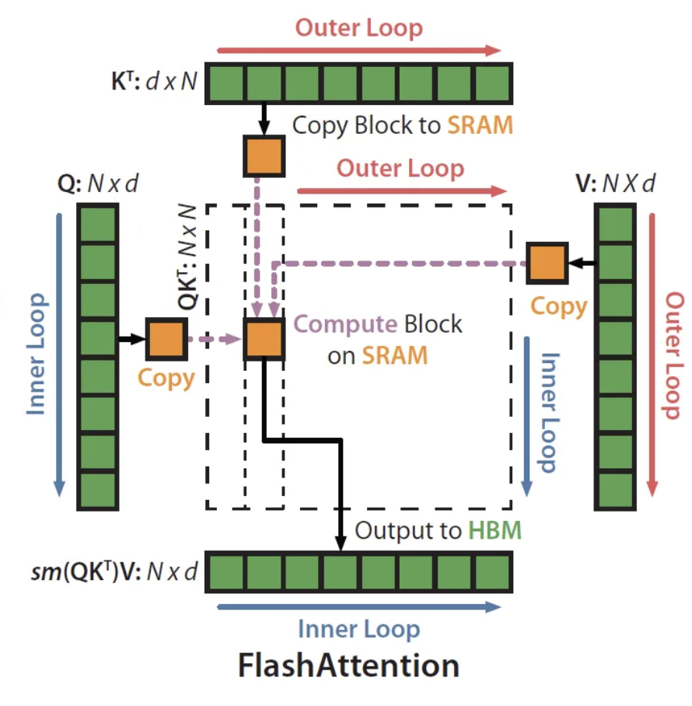
Operator Fusion (Operator Fusion)
Core Definition:
Merging multiple adjacent independent operators in the computation graph (e.g., Conv + BN + ReLU) into a single, more efficient execution kernel .
Key Benefits:
Eliminating intermediate feature map read/write DRAM bandwidth consumption .
Significantly reducing kernel launch (Kernel Launch) overhead .
Lowering peak memory usage during inference deployment.
Three Core Stages:
Graph Matching: Finding specific topological structures in the computation graph.
Pattern Recognition: Validating semantic legality and physical constraints.
Subgraph Rewriting: Performing equivalent graph transformations.
Dao, Tri, et al. "Flashattention: Fast and memory-efficient exact attention with io-awareness." Advances in neural information processing systems 35 (2022): 16344-16359.

Slide 5
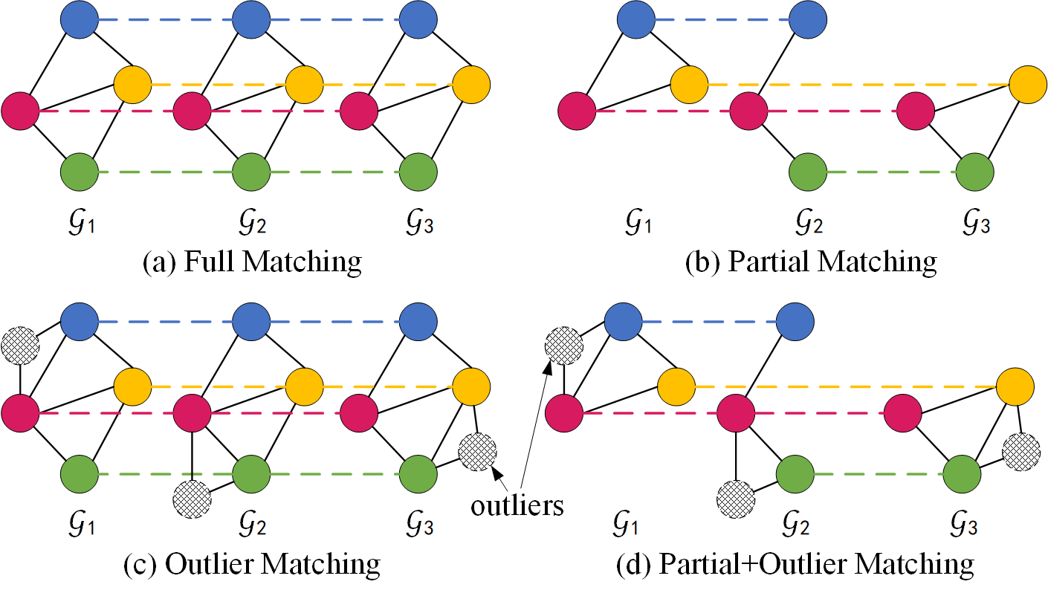
Graph Matching Algorithm (Graph Matching)
Directed Acyclic Graph (DAG):
Data structure for neural networks in compilers, with nodes representing operators and edges representing tensor data flow.
Subgraph Isomorphism Problem:
Defining fusion rules as a pattern graph (Pattern Graph), and searching for exact matches in the host computation graph (Host Graph) .
Computational Complexity:
Traditional full graph matching is an NP -Complete problem, but deep learning computation graphs have strong domain-specific properties enabling significant pruning .
https://thinklab.sjtu.edu.cn/project/GANN-GM/index.html

Slide 6
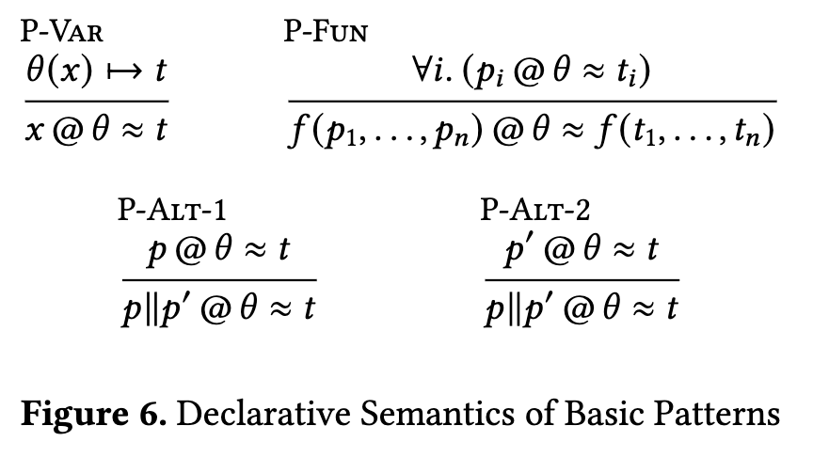
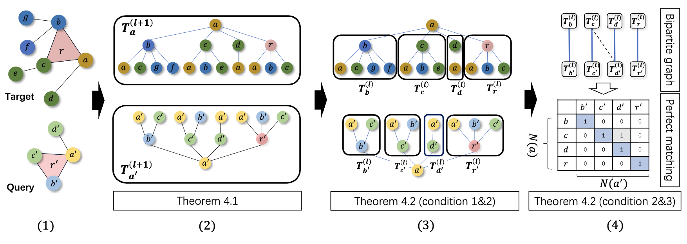
Graph Matching Acceleration Strategies
Strong Type Label Filtering: Hash-based filtering by operator type (e.g., Conv2D, BatchNorm), quickly excluding incompatible nodes.
Topological Sort and Use-Def Chains: Traversing along or against the tensor's“Using-Definition” chain for local depth-first traversal, limiting the search space.
Approximate and Degenerate Matching: Some advanced compilers employ graph neural networks or structural degeneracy properties, reducing matching time complexity to linear level .
Cutler, Joseph W., et al. "Pattern Matching in AI Compilers and its Formalization (Extended Version)." arXiv preprint arXiv:2412.13398 (2024).
Liu, Xuanzhou, et al. "D2match: leveraging deep learning and degeneracy for subgraph matching." International Conference on Machine Learning. PMLR, 2023.

Slide 7
Pattern Recognition (Pattern Recognition)
Dataflow Constraints and Exclusivity Analysis
DAG, an operator's output may be consumed by multiple downstream operators, , when performing vertical fusion, the compiler must conduct strict liveness and multi-user checks.
Operation Attributes and Shape Constraints
Tensor Dimension Verification: Matching logic must verify whether input tensor shapes and dimensions meet fusion requirements (e.g., alignment requirements).
Memory Layout: Hardware acceleration libraries (e.g., cuDNN) typically have strict NCHW or NHWC have strict data layout requirements.
Cost Model-Based Benefit Assessment
Fusion is not always optimal: Excessive fusion may cause local variable explosion and register spilling.
Hardware-Aware Cost Model: Automatically evaluating the balance between computation, data transfer, and launch overhead.
Benefit Constraint: If the cost model predicts negative benefit from fusion, the recognition engine proactively abandons the merge .

Slide 8
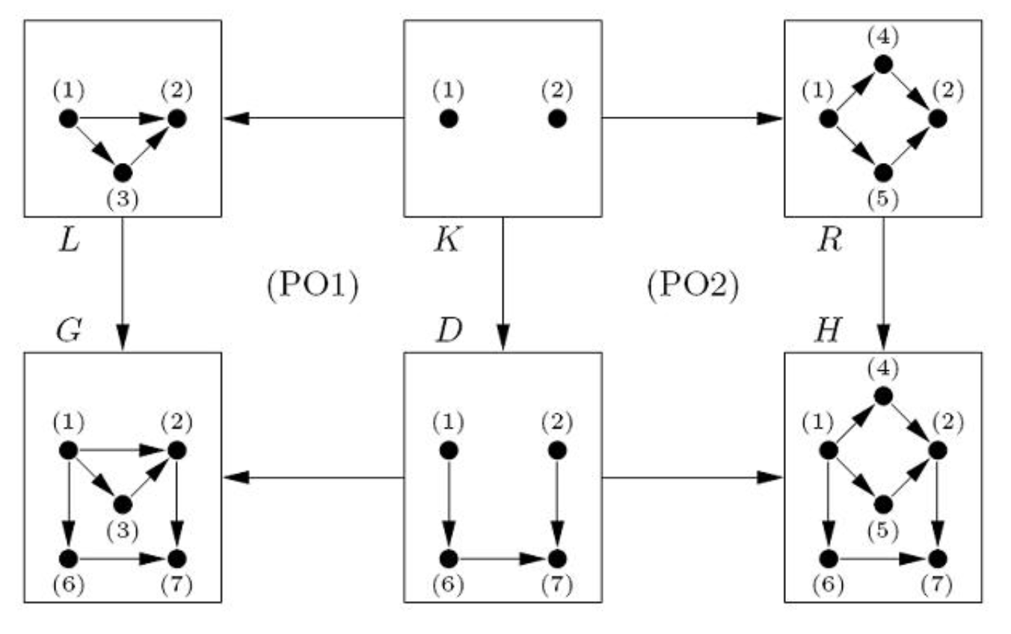
Subgraph Rewriting (Subgraph Rewriting)
Semantically Equivalent Graph Transformation Theory
L --> R：where L called the pattern graph (Pattern Graph), representing the subgraph structure to be replaced;R called the replacement graph (Replacement Graph), representing the efficient fused structure.
Double-Pushout (DPO) Semantic Framework: The host graph is partitioned into the match portion (Match), context (Context) , and patch/interface edges connecting the two (Patch/Interface) .
Core Principle: Semantic equivalence must be guaranteed, i.e., given the same input, computation output before and after rewriting must remain absolutely identical.
https://www.cas.mcmaster.ca/~kahl/CAS701/2007/P/DPO.pdf

Slide 9
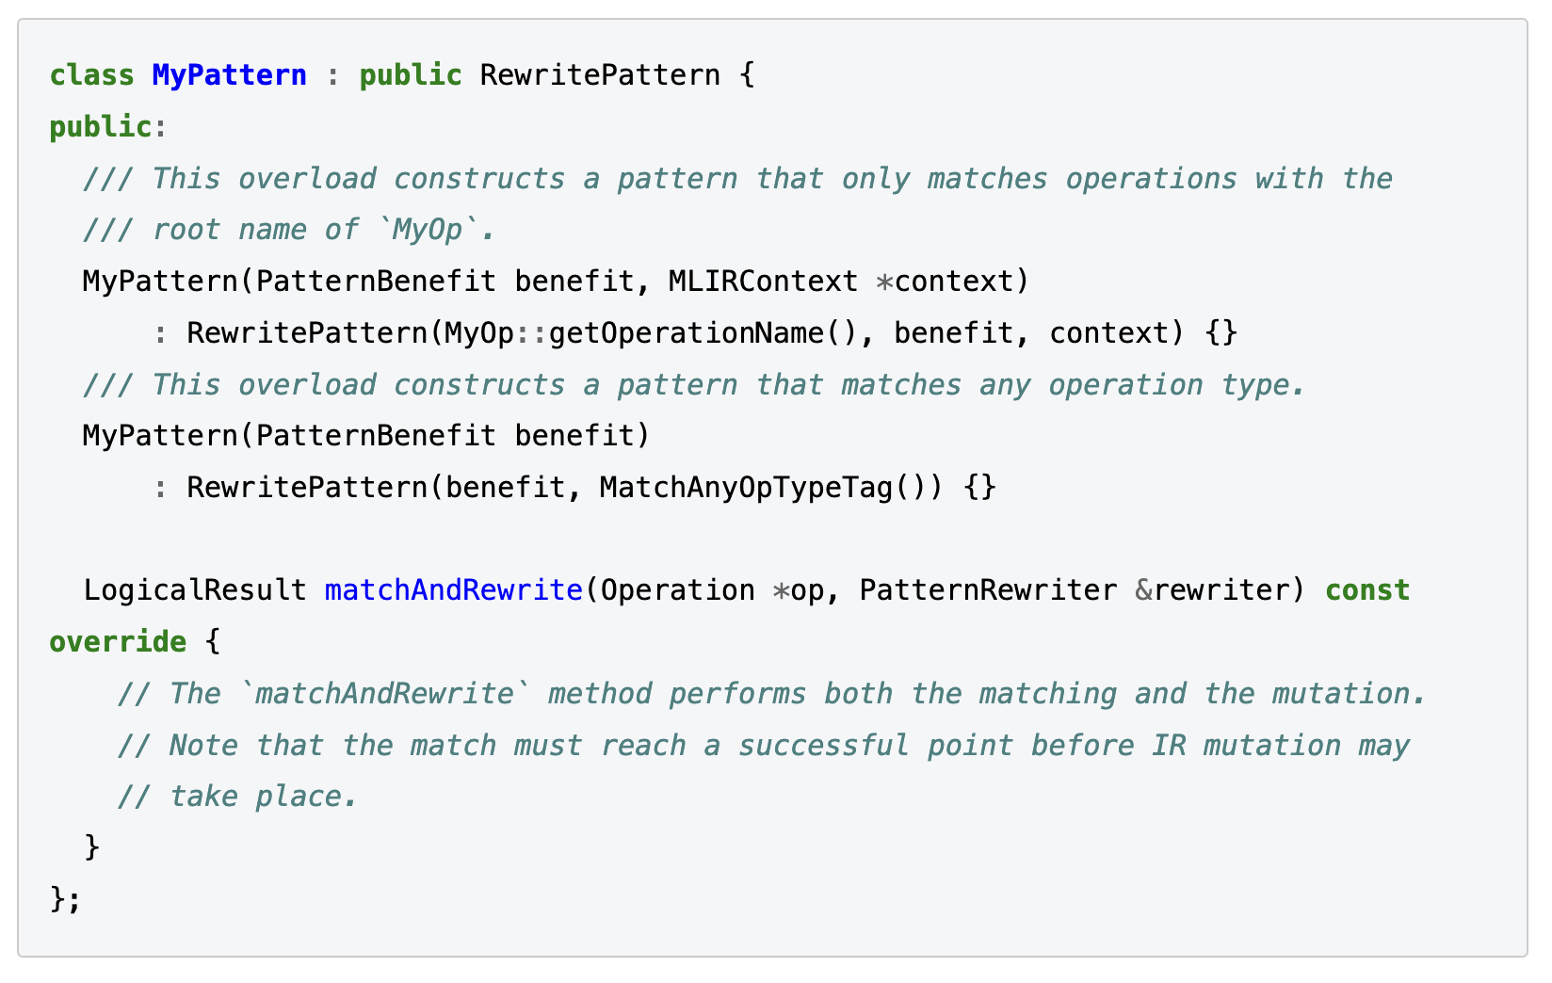
MLIR Pattern Rewrite Engine
Decoupled Design:
MLIR strictly decouples pattern definition from pattern application (e.g., Greedy Pattern Rewrite Driver).
Imperative Writing:
C++ RewritePattern: inheriting from OpRewritePattern, overriding thematchAndRewrite Function
Characteristics:
Full freedom to directly manipulate low-level IR and compute complex mathematical logic.
Drawbacks: Excessive boilerplate code, manual type conversion and safety checks required, graph topology not intuitive.
https://mlir.llvm.org/docs/PatternRewriter/#matchandrewrite-implementation

Slide 10
MLIR Pattern Rewrite Engine
DRR (Table-driven Declarative Rewrite Rule, DRR):
Using DAG syntax (Source DAG) -> (Result DAG) syntax for declaring rules, expanded to C++ code at compile time, greatly reducing boilerplate .
More modern PDLL: Specifically designed for MLIR syntax-designed pattern description language .
Natively supporting multi-result operations, regions, and variadic arguments .
Allowing constraint conditions and mathematical logic expressions to be declared directly within the language .
Supporting AOT Compile-time and runtime JIT bytecode interpretation execution .
https://mlir.llvm.org/docs/DeclarativeRewrites/
https://mlir.llvm.org/docs/PDLL/

Slide 11
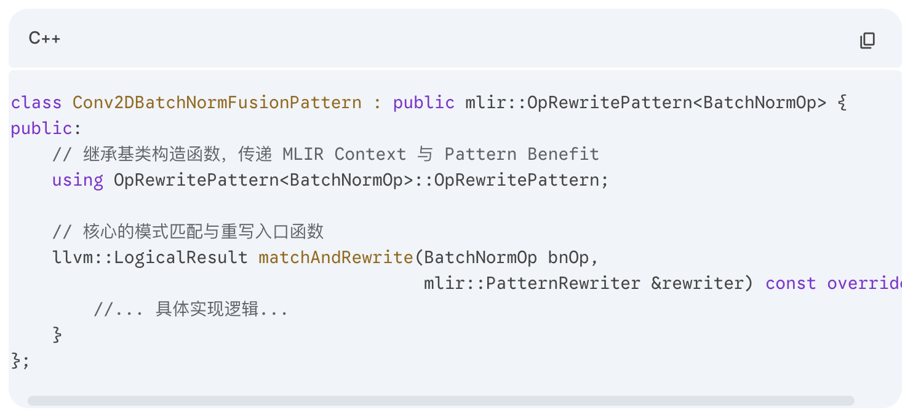
in MLIR Writing in Conv+BN Fusion Pass
Pattern Definition and Root Node Selection
Inheriting Base Class: In C++ create a class inheriting from OpRewritePattern<BatchNormOp> class .
Anchoring the Root Node (Root Node): Setting the pattern matching trigger point to the downstream BatchNormOp.
Reverse Tracing Advantage: From consumer (BN) tracing upstream to producer (Conv2D) is deterministic and unique, greatly reducing the logical complexity of multi-path search.

Slide 12
in MLIR Writing in Conv+BN Fusion Pass
Graph Traversal and Safety Verification (Match Logic)
Node Location: Via getDefiningOp() from BN 's input node and verifying whether it comes from Conv2DOp .
Multi-User Blocking Mechanism: The most critical safety check. Verifying whether the convolution output tensor result is exclusively used by this single BN node.
API Call: Mandating that convOp.getResult().hasOneUse() returns True, preventing weight rewriting from polluting external dependency branches (e.g., residual connections) .

Slide 13
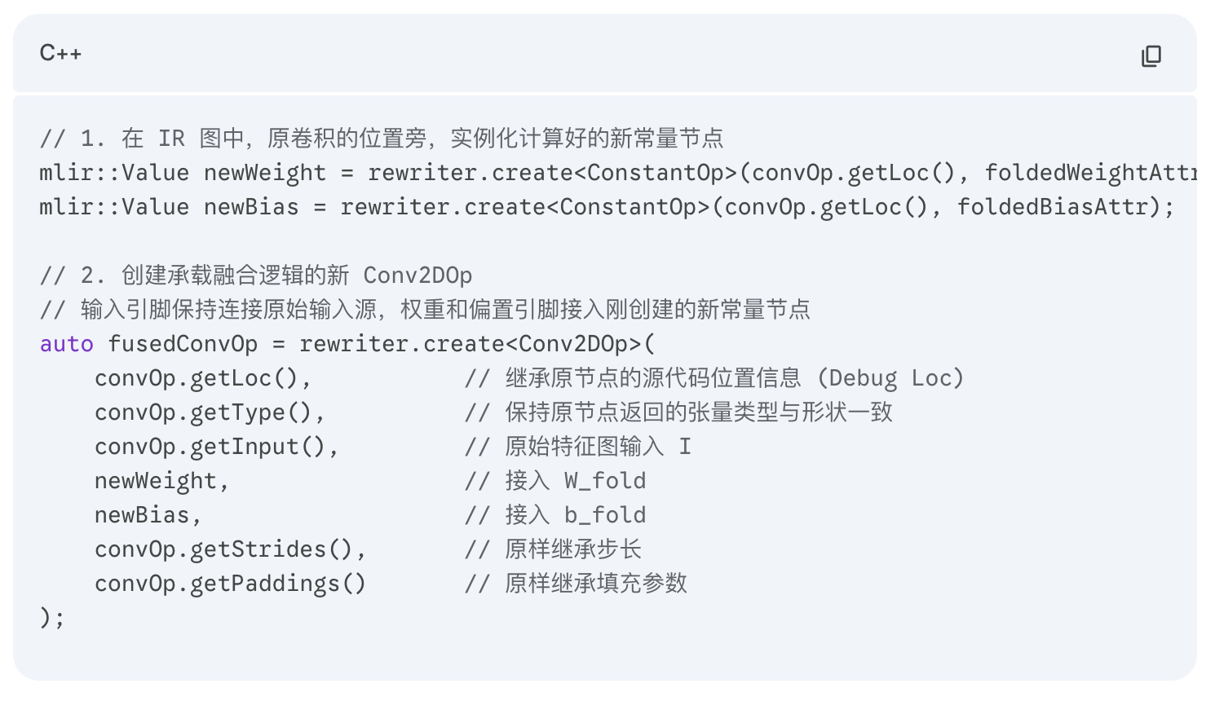
in MLIR Writing in Conv+BN Fusion Pass
Execute Rewriting and Dataflow Switching
Constant Reading and Computation: Reading global BN statistical attributes at compile time, using C++ to compute new W_{fold} and b_{fold} dense tensors.
Graph Materialization and Switching: Calling rewriter.create to instantiate new constant nodes and the fused Conv2DOp.
call rewriter.replaceOp(bnOp, fusedConvOp.getResult()) to switch all downstream connections to the new node .
Clean up old nodes rewriter.eraseOp(convOp).

Slide 14

The Solution: FlagOS, a Unified AI Software Stack

Slide 15








https://space.bilibili.com/3546791834290849
https://github.com/flagos-ai
https://www.zhihu.com/people/95-22-20-18/posts
https://flagos.io/Home

Slide 16
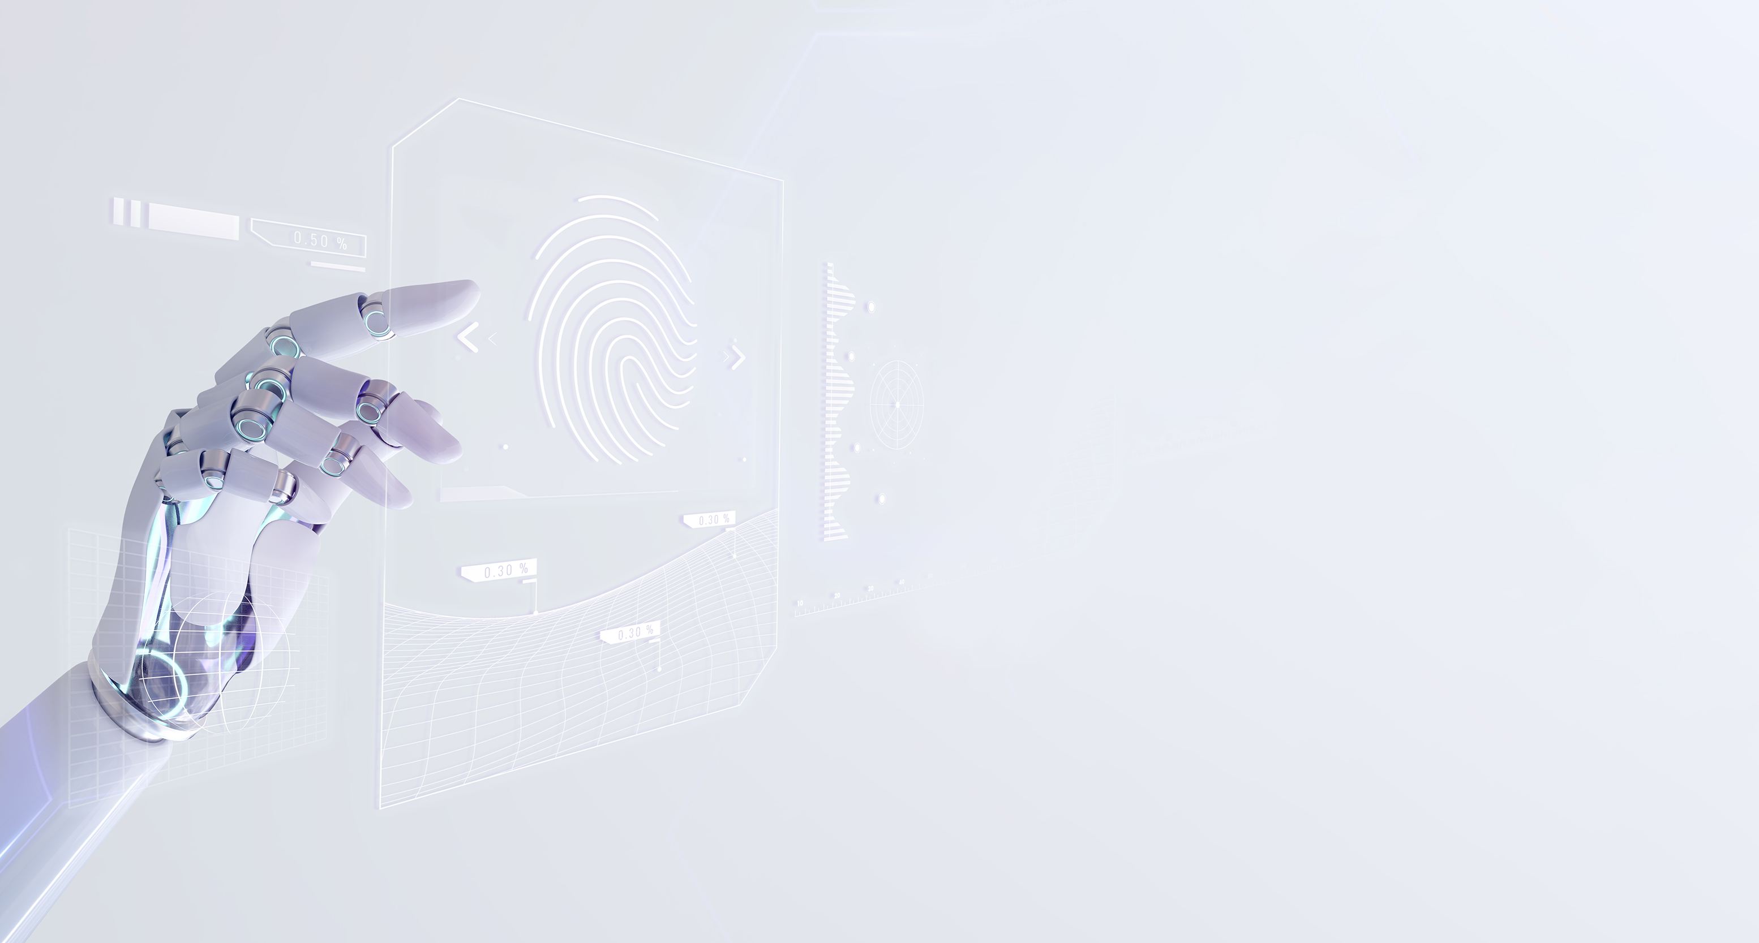
Thanks for your time！

